Slide 1
Greedy Algorithm

Slide 2

Content
Real World Example
Introduction
Application
Advantages & Disadvantages

Slide 3

HELLO
I AM FOXIE

Slide 4

COLLECTING MONEY
IT HAS 4 COINS BAGS
5$
coins
50$
coins
20$
coins
10$
coins

Slide 5

Make 85 $ from coins Bags
POSSIBLE COMBINATIONS
NOW WHAT TO DO ?
17 coins of 5$
8 coins of 10$+ 1 coin of 5$
4 coins of 20$+1 coin 0f 5$
1 coin of 50$+1 coin 0f 10$ +2 coins of 20$+1 coin of 5$
Need to choose the Optimal solution for this case
A greedy algorithm sometimes works well for optimization problems

Slide 6

Greedy approach
So Foxie came with an idea of selecting coins with minimum number of coins, using greedy algorithm.
50$
20$
10$
5$
Total coins weightage=50+20+10+5=85

Slide 7
Definition
A Greedy algorithm is an approach to solving a problem that selects the most appropriate option based on the current situation.
This algorithm ignores the fact that the current best result may not bring about the overall optimal result. Even if the initial decision was incorrect, the algorithm never reverses it.

Slide 8
Condition implementation
We can implement a greedy solution only if the problem statement follows two properties
Greedy Choice Property: Choosing the best option at each phase can lead to a global (overall) optimal solution.
Optimal Substructure: If an optimal solution to the complete problem contains the optimal solutions to the sub problems, the problem has an optimal substructure.

Slide 9
Steps for Creating a Greedy Algorithm
Start from the source vertex.
Pick one vertex at a time with a minimum edge weight (distance) from the source vertex.
Create an iterative process for going over all sub problems and creating an optimum solution.

Slide 10
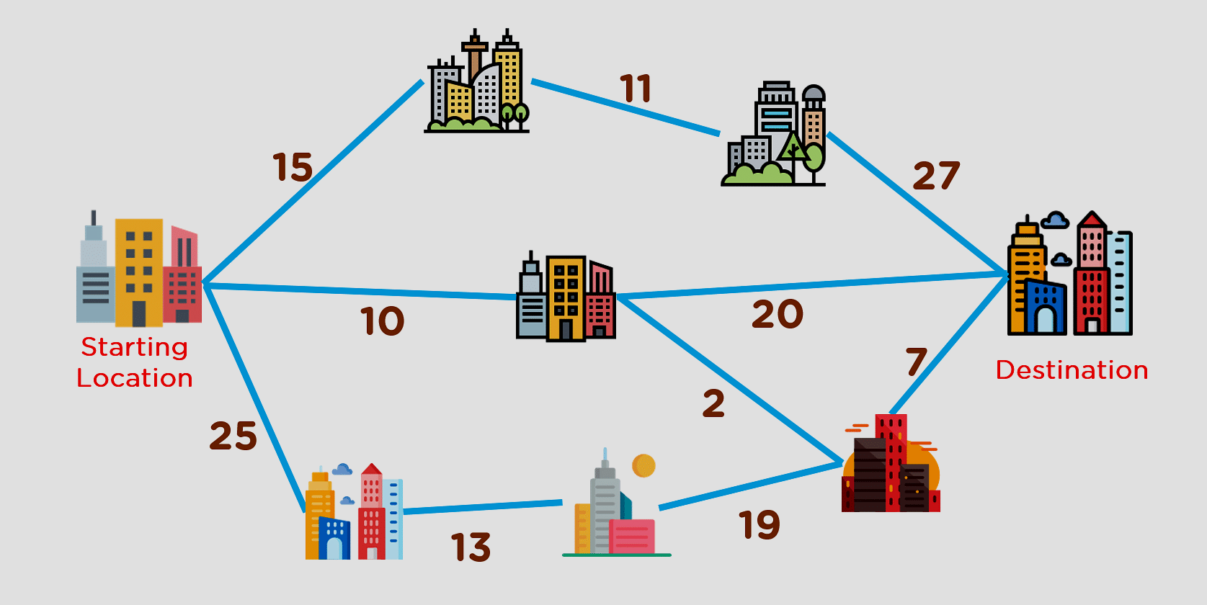
Example of Greedy Algorithm
Problem Statement:
Find the best route to reach the destination city from the given starting point using a greedy method.

Slide 11
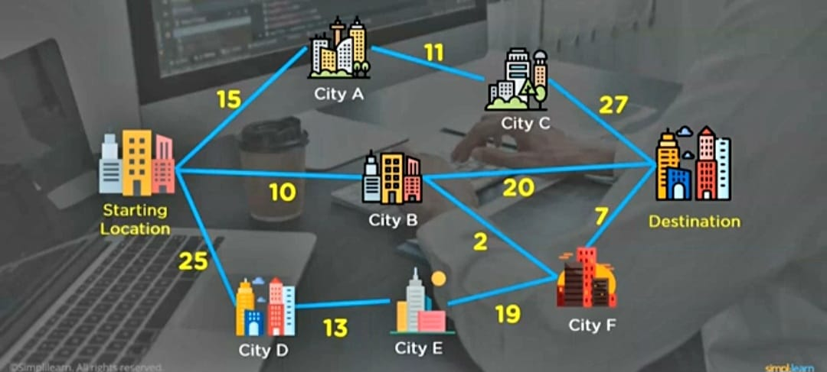
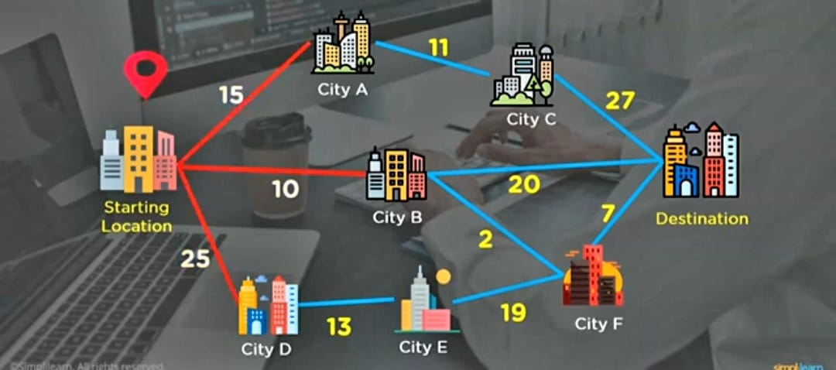
Solve the sales man problem using greedy solution
A sales man wants to deliver a packet and he has to select a shortest path from his starting location to destination location.
He starts from starting location and see shortest path from his nearby city to reach his destination city.

Slide 12
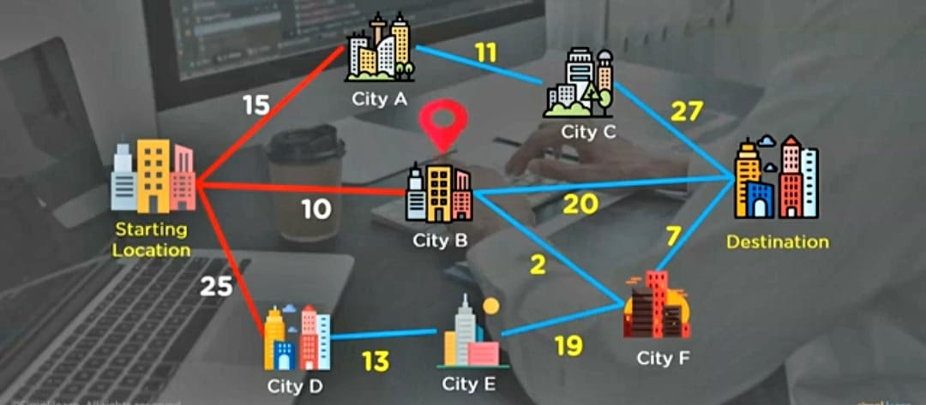
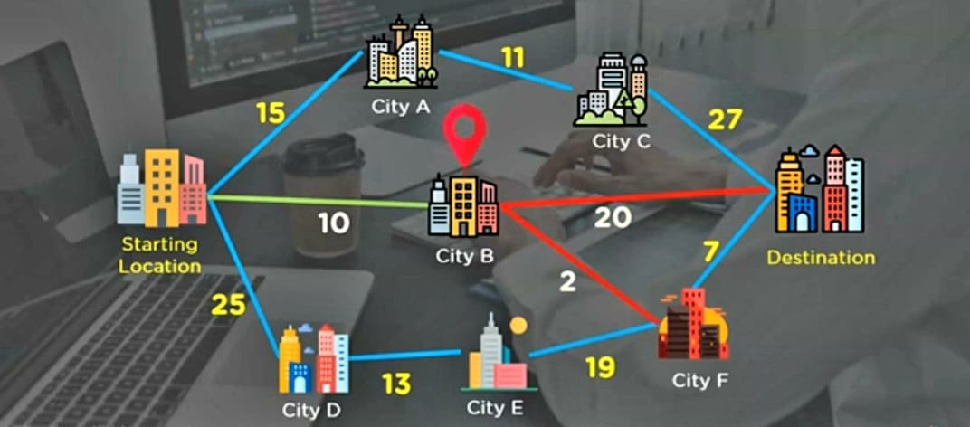
He selects a shortest path which is City B=10
After reaching at City B, he discovers near by cities of City B.

Slide 13
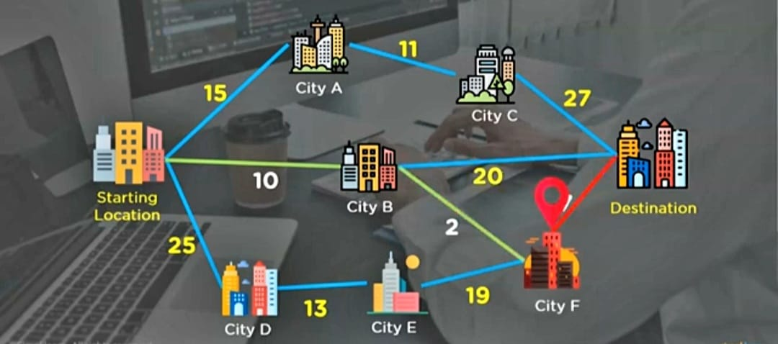
After selecting shortest path from city B, he selects City F with shortest path which is City F=2
After reaching at City F, he discovers its near by cities to reach his destination.

Slide 14
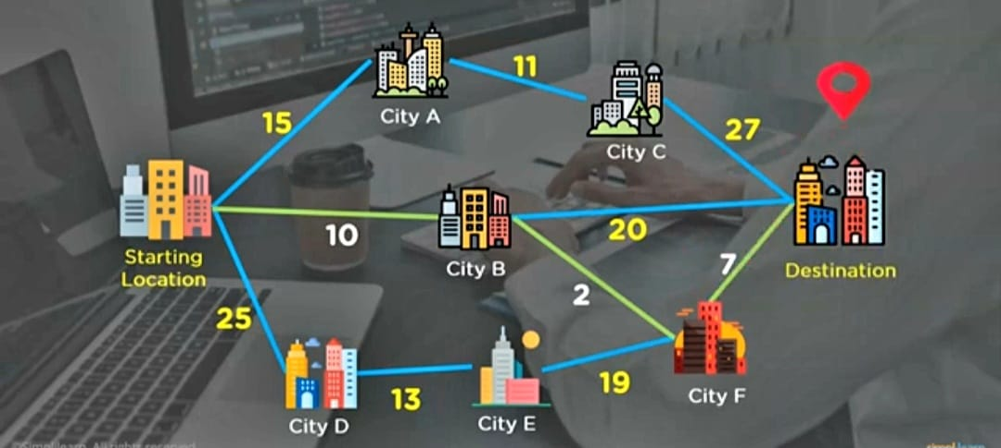
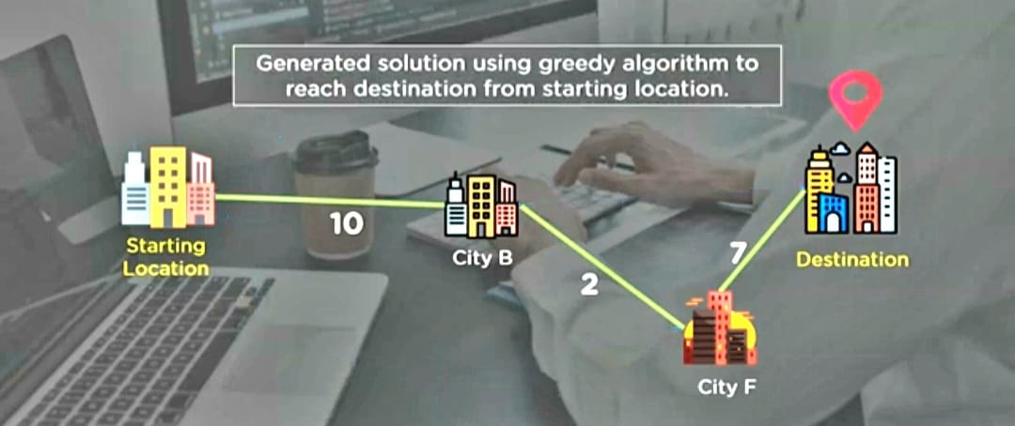
After discovering near by cities of City F which is only one and that is destination city too.
Total time taken=10+2+7=19

Slide 15
Applications of the greedy algorithm
Used for Constructing Minimum Spanning Trees: Prim’s and Kruskal’s Algorithms.
Used to Implement Huffman Encoding
Graph - Map Coloring, Graph - Vertex Cover, Knapsack Problem, Job Scheduling Problem

Slide 16
Advantages of Using Greedy Algorithms
The implementation of the greedy method is easy because it takes the best possible solution.
cheaper than most of the other Algorithms.
easy to understand and implement.

Slide 17
Disadvantages of Using Greedy Algorithms
Does Not find the optimal solution to a problem. In other words, it may not produce the best possible outcome.
Additionally, greedy algorithms can be very sensitive to changes in input data — even a small change can cause the algorithm to produce a completely different result.

Slide 18
Kruskal's Algorithm

Slide 19
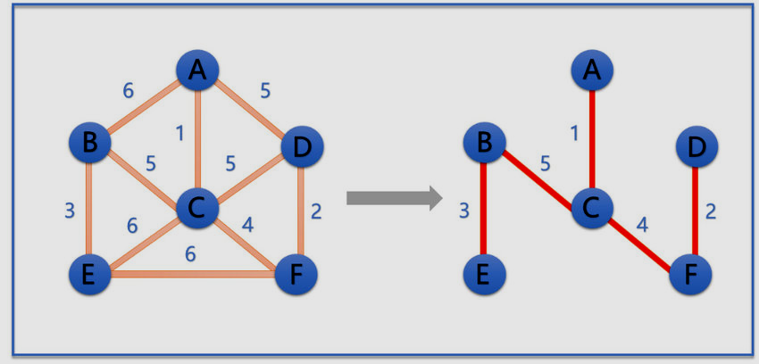
Introduction
Kruskal's algorithm is a minimum spanning tree algorithm that takes a graph as input and finds the subset of the edges of that graph which
form a tree that includes every vertex
has the minimum sum of weights among all the trees that can be formed from the graph

Slide 20
Real-world Examples
In order to layout electrical wiring
In computer network (LAN connection)
Landing cables
Game Development

Slide 21
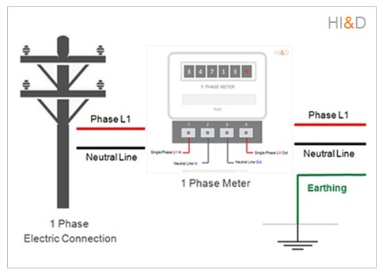
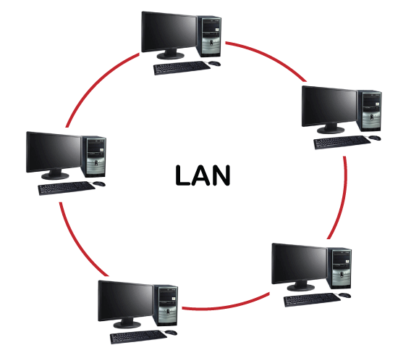
Real-world Examples
In order to layout electrical wiring
In computer network (LAN connection)

Slide 22
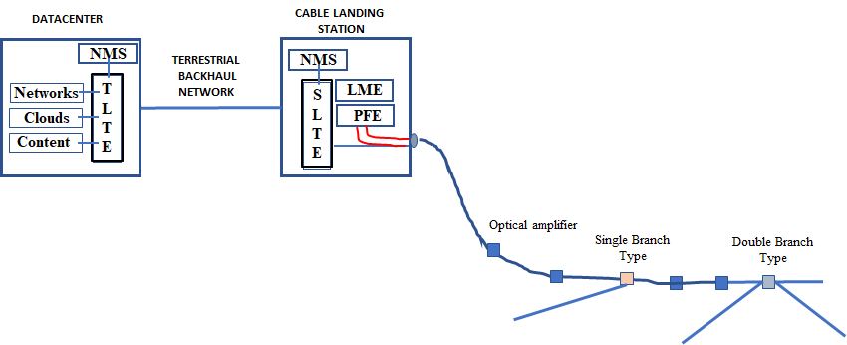

Landing cables
Game Development

Slide 23
How Kruskal's algorithm works?
It falls under a class of algorithms called greedy algorithms that find the local optimum in the hopes of finding a global optimum.
We start from the edges with the lowest weight and keep adding edges until we reach our goal.

Slide 24
The steps for implementing Kruskal's algorithm are as follows:
Sort all the edges from low weight to high
Take the edge with the lowest weight and add it to the spanning tree. If adding the edge created a cycle, then reject this edge.
Keep adding edges until we reach all vertices.

Slide 25
Pseudocode
KRUSKAL(G): A = ∅ For each vertex v ∈ G.V: MAKE-SET(v) For each edge (u, v) ∈ G.E ordered by increasing order by weight(u, v): if FIND-SET(u) ≠ FIND-SET(v): A = A ∪ {(u, v)} UNION(u, v) return A

Slide 26
Example
A cable company want to connect five villages to their network which currently extends to the market town of Avonford. What is the minimum length of cable needed?

Slide 27
Brinleigh
5
Cornwell
3
6
4
8
8
Avonford
Fingley
Donster
7
5
4
2
Edan

Slide 28
We model the situation as a network, then the problem is to find the minimum connector for the network
B
5
C
3
4
8
6
8
A
F
D
7
5
4
2
E

Slide 29
List the edges in order of size:
ED 2
AB 3
AE 4
CD 4
BC 5
EF 5
CF 6
AF 7
BF 8
CF 8
B
5
C
3
4
8
6
8
A
D
7
F
5
4
2
E

Slide 30
B
5
Select the shortest edge in the network
ED 2
C
3
4
8
6
B
5
C
8
3
A
D
7
F
4
8
6
5
4
8
2
A
D
7
F
E
5
4
2
Select the next shortest edge which does not create a cycle
ED 2
AB 3
E

Slide 31
B
5
C
3
Select the next shortest
edge which does not
create a cycle
ED 2
AB 3
CD 4 (or AE 4)
4
8
6
8
A
D
7
F
5
4
2
E

Slide 32
B
5
C
3
Select the next shortest
edge which does not
create a cycle
ED 2
AB 3
CD 4
AE 4
4
8
6
8
A
D
7
F
5
4
2
E

Slide 33
B
5
C
Select the next shortest
edge which does not
create a cycle
ED 2
AB 3
CD 4
AE 4
BC 5 – forms a cycle
EF 5
3
4
8
6
8
A
D
7
F
5
4
2
E

Slide 34
B
5
C
All vertices have been
connected.
The solution is
ED 2
AB 3
CD 4
AE 4
EF 5
Total weight of tree: 18
3
4
8
6
8
A
D
7
F
5
4
2
E

Slide 35
Complexity
Time Complexity O(E log V)
Space complexity O(V)

Slide 36
Advantages
being able to create MSTs for disconnected graphs (components)
achieving O(E log V) complexity using a straightforward heap data structure while Prim’s requires more complex Fibonacci heaps
faster finding an MST for sparse graphs (but Prim’s works better with dense graphs)

Slide 37
Limitations
Greedy algorithms for some optimization problems fail, but creating a MST isn’t among them.
Kruskal’s algorithm solves the Minimum Spanning Tree problem, that’s all. It will always produce a minimum spanning tree.

